Slide 1
Team Cookie Council
Girl Scout Badge Tracking Application
For The Girl Scouts of America
Matt, 1

Slide 2
Team Roles
Scrum Master
Ryan Schroeder
Customer Proxy
Nate Martz
Quality Assurance
Mike Glosecki
Database Architect
Matt Eck
Customer Representative
Jennifer Melton
Matt, 2

Slide 3
Project Introduction
Purpose:
Replace the paper documentation system currently used by Girl Scout leaders.
Functions:
Badge Tracking, Financial Tracking, Event Tracking, and Shopping List Creation.
Proposed System:
Web page, iOS & Android mobile application
Matt, 3

Slide 4
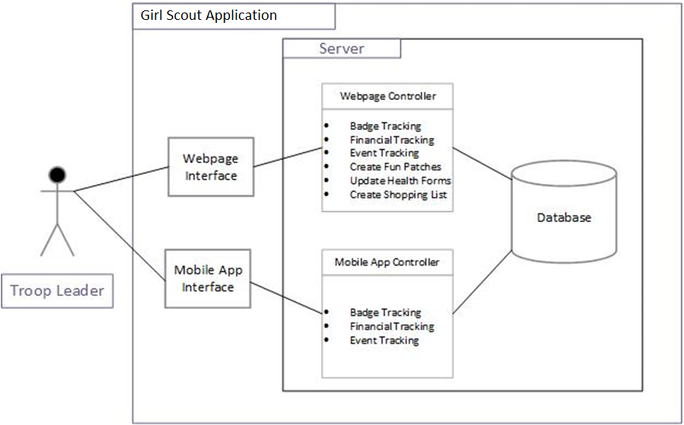
Proposed Architecture
Ryan, 4

Slide 5
Project Management and Risks
Bi-weekly Standup meetings
Briefly discuss risks and team member progress
Constant contact with team members using google hangouts application and Email updates to client
Mobile Application Development
Meeting with Computer Science Prof. Socratis Tornaritis
No access to a web server
Using XAMPP to host the database locally
Ryan, 5

Slide 6
Quality Assessment and Testing
Behavior Driven Design testing from scenarios
Input Validation for correctness of functions and data
First using dummy data, then real data
Maintenance Instructions and meaningful error reports
Mike, 6

Slide 7
CS425 Estimated Exit Strategy
Usable web interface for record keeping
Completion of an iOS prototype application
Client Feedback Analysis of prototypes
Mike, 7

Slide 8
Efforts
Matt & Ryan
Database
MySQL
Entity Relationship Diagram
Mobile Development
Meeting with Socratis Tornaritis
PhoneGap prototype
Ryan, 8

Slide 9
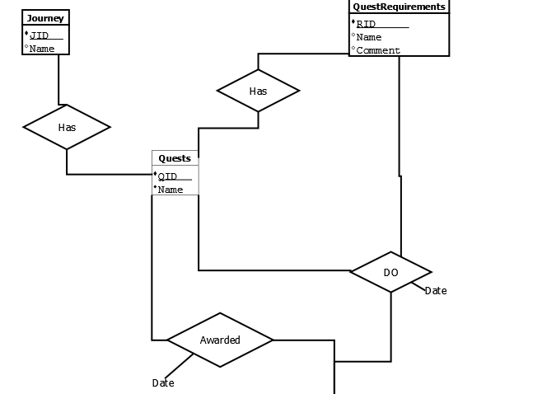
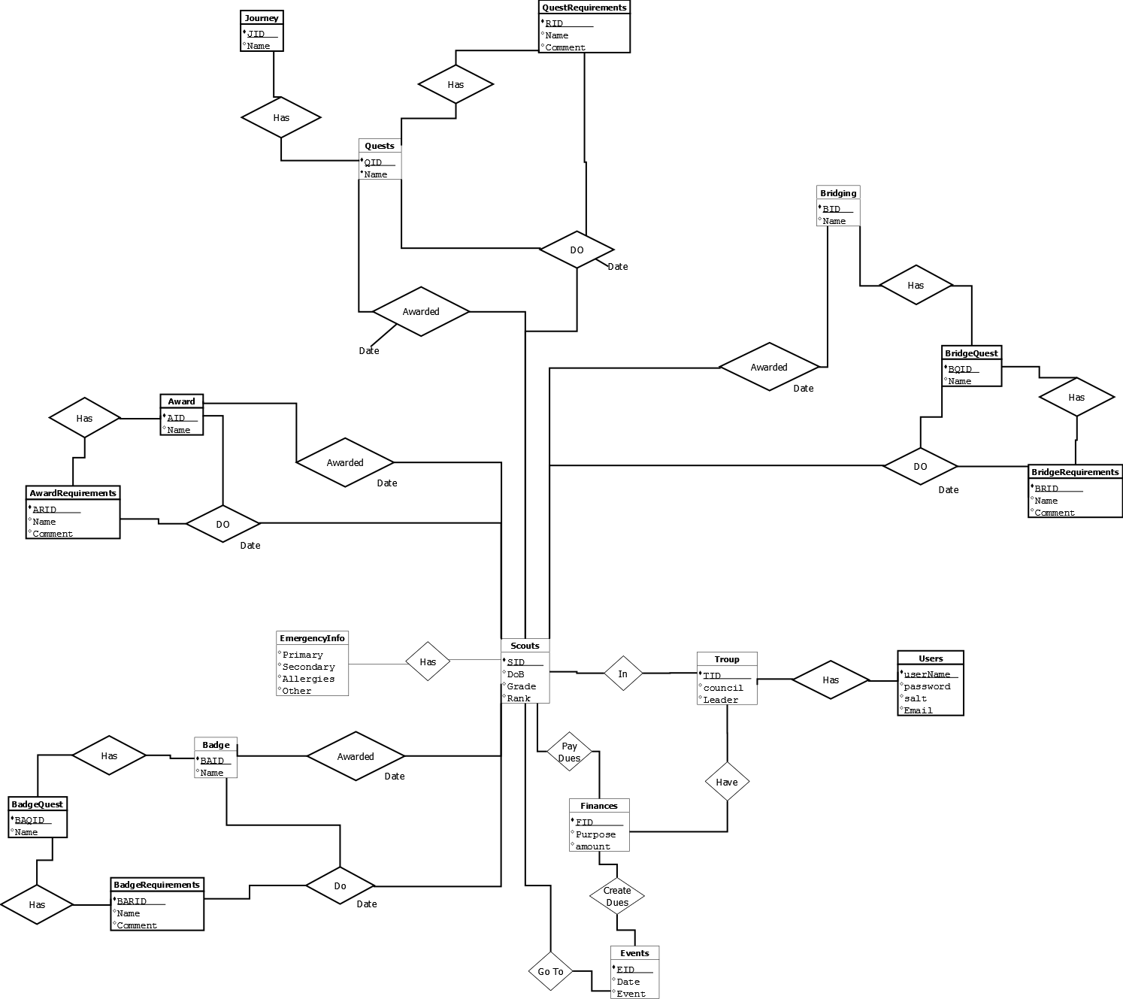
Entity Relationship Diagram
Matt, 9

Slide 10
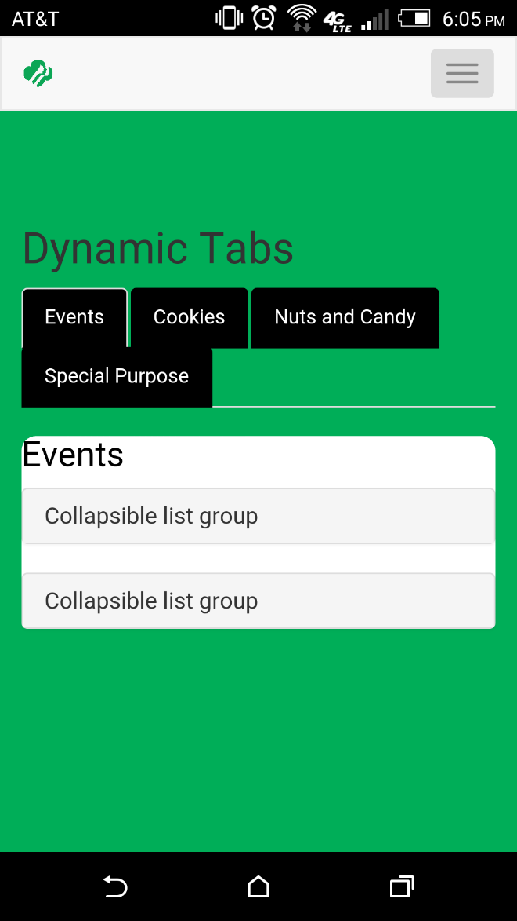
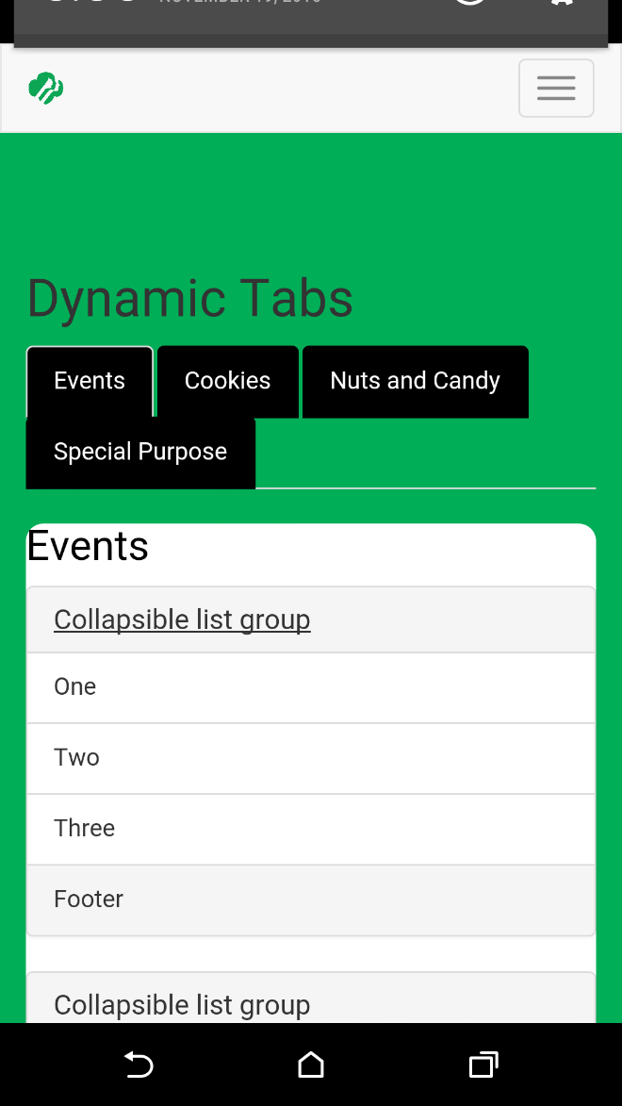
Mobile Prototype
Ryan, 10

Slide 11
Efforts Cont.
Mike & Nate
Web Development
HTML
CSS
Jquery
Bootstrap
PHP with SQL queries
Nate, 11

Slide 12
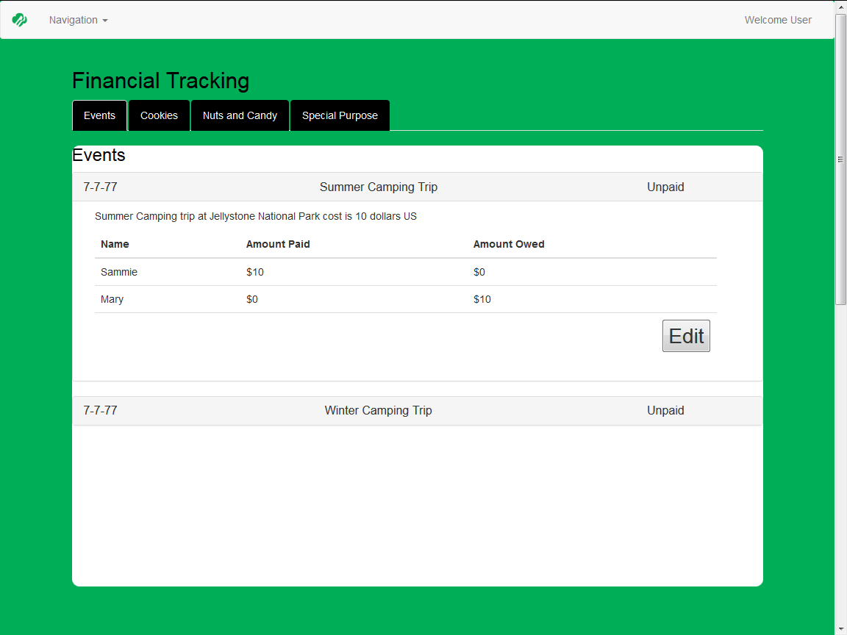
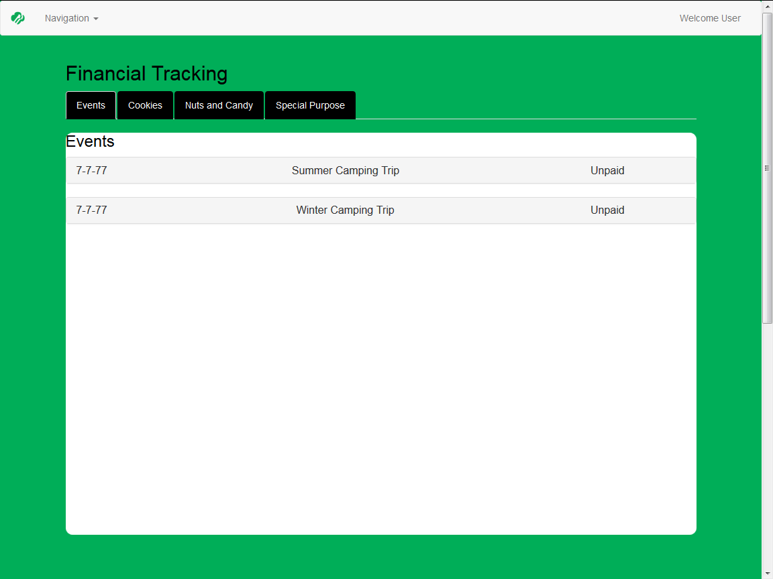
Web Page Template
Nate, 12

Slide 13
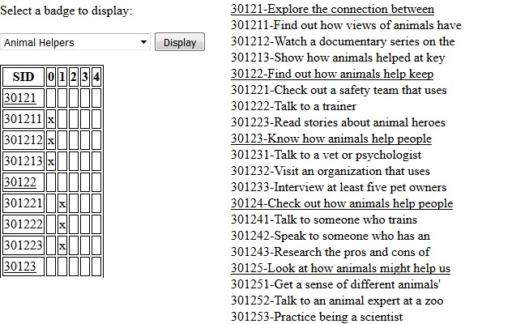
Badge Tracking System
Mike, 13

Slide 14
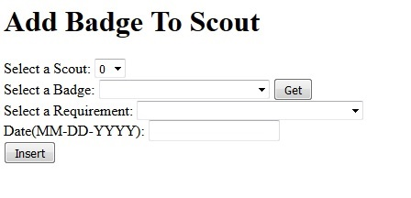
Badge Insertion Page
Mike, 14

Slide 15
Completed Components
All goals were achieved.
Core components:
Basic, functional web application
Simple Mobile Application
Complete database
Mike, 15

Slide 16
Post Mortem
Good:
Strong team dynamics
High levels of effort
Bad:
Version control and use of BitBucket
Varying Sprint person hour estimations
Nate, 16

Slide 17
Plans for Next Semester
Refinement of basic web pages with database interactions
Usability testing
Completion of Android and iOS mobile applications
Nate, 17

